Slide 1
Nimbus Navigator
Anja Delzell, Cooper Baugh, Logan Moser, Grant Parker, Max McClelland

Slide 2
Agenda
Project Description
Tools Used for Creation
Architecture Diagram
Challenges Undergone
Future Enhancements
Demo

Slide 3

Project Description
Why our Children Friendly Weather App is for You

Slide 4
About Nimbus Navigator
Nimbus Navigator is an application for children that offers a rich and dynamic weather experience. This app allows children to learn about the weather in a fun, interactive way.
It utilizes features designed for both information and education, displaying weather at the user’s location and allowing the user to involve themselves with our interactive games and information.
Our vision is “For children to view the forecast while being immersed in a feature-rich environment focused on weather and climate education for adolescents.”

Slide 5

Project Features
Our project contains 4 main pages including:
Current Weather Page
Weekly Forecast Page
Weather Facts Page
Climate Contest Page
The project also contains a login, logout and register page.

Slide 6
Tools Utilized for Nimbus Navigator
What we used. How it worked.

Slide 7





What we Used… And How
Github Project Board (⭐⭐⭐⭐) – Used to track updates made for our project
Github Repository (⭐⭐⭐⭐) – Used to store our version history and project information
HTML (⭐⭐) – Markup language used to write and run our program on the web
Bootstrap (⭐⭐⭐⭐) – Framework used for design of project
CSS (⭐⭐⭐) – Stylesheet used for design of project
NodeJS (⭐⭐⭐) – Application server used for backend of project

Slide 8





Tools Used (Continued)
PostgreSQL (⭐⭐⭐⭐⭐) – The relational database we used for our project
Handlebars (⭐⭐⭐⭐) – Used for templating web design
Render (⭐⭐⭐⭐) – Used to deploy our application
Express.js (⭐⭐⭐⭐) – Framework of node JS
National Weather Service API (⭐⭐⭐) – Used to receive data for the weather
Farm Sense API (⭐⭐⭐⭐) – Used for icons implemented in our project

Slide 9
Architecture Diagram
Architecture used for application and flow of data

Slide 10
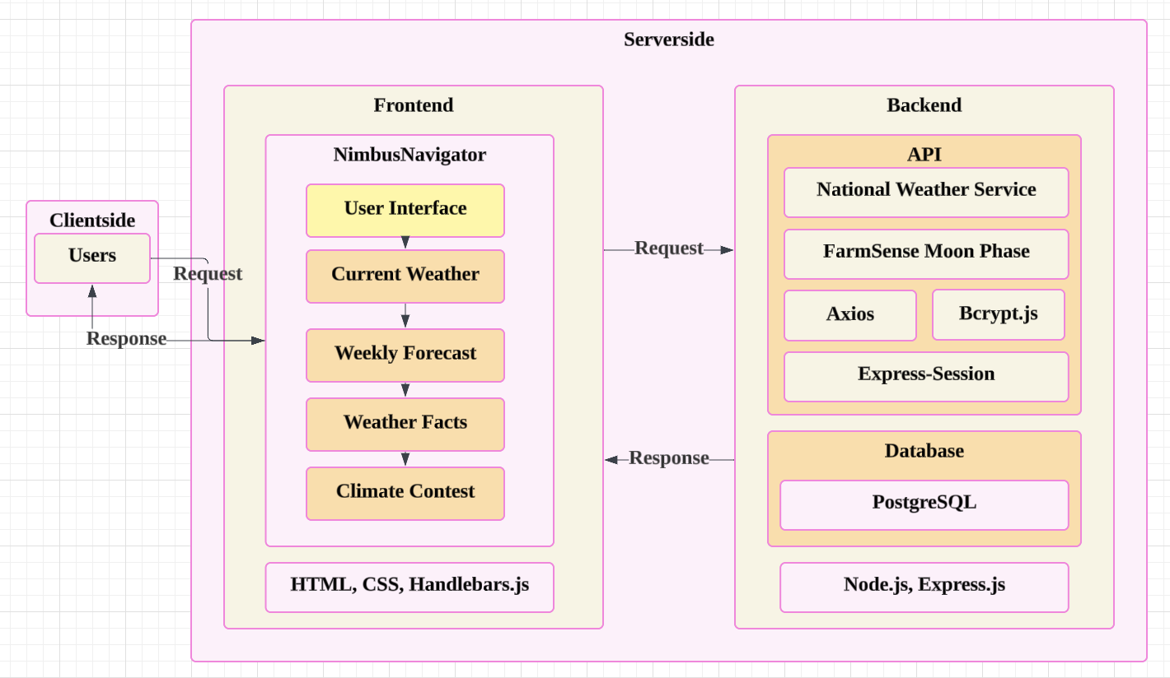
Architecture Diagram

Slide 11
Challenges Encountered
Struggles Faced and Overcome

Slide 12
Overview of Challenges Encountered
Our group encountered a variety of challenges in the implementation of this project. We persevered through them all, from formatting issues to a lack in prompt engineering skills. These were our main issues:
Formatting Challenges
Navbar formatting challenges
Image Generation Challenges
Challenge with making Zip Code work for areas other than boulder

Slide 13

Formatting and Navbar Challenges
Formatting Challenges – A variety of challenges with formatting were faced, the most pressing of which being making the cards line up on the Current Weather page. This was resolved after reviewing formatting and using a grid system.
Navbar Challenges – With the creation of the Hamburger Menu there was a problem with keeping Logout on the right side of the page. This was fixed after lots of reviewing documentation and changing the <div> that the Logout was inside.

Slide 14
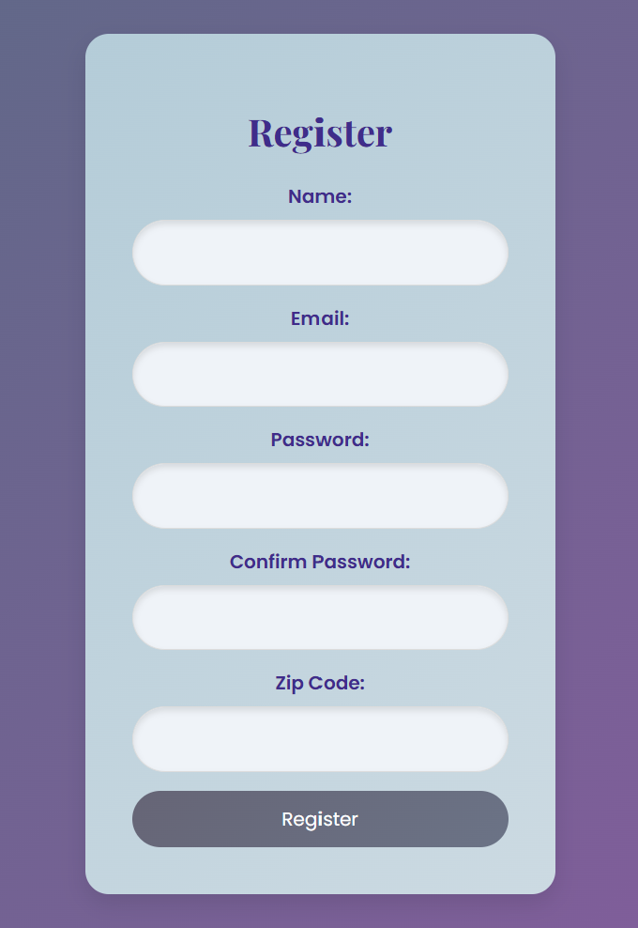
Image Generation and Zip Code Challenges
Image Generation – This was a challenge because since we generated our app images using AI, we needed images to be uniform in style and we needed images to be to our groups liking. It took a lot of writing and rewriting image prompts and two sets of weather images for us to finally decide on the images we chose.
Zip Code challenges - The zip code problem was fixed by using the "zipcodes" library which converts the user’s zip code into latitude and longitude coordinates. These coordinates are employed to make API calls to fetch weather data, such as current conditions and forecasts, from external services like the National Weather Service and with this library our team was able to make any zip code work.

Slide 15

The Future of Nimbus Navigator
Dreams for further innovation

Slide 16

Future Aspirations For Nimbus Navigator
We would have better formatting for the weekly weather page as putting all that data into 7 cards becomes a bit chaotic.
We would create a feature where you could edit your profile. This would allow people to change passwords, usernames and emails. People could also edit their zip code so if they traveled or moved, Nimbus Navigator could move with them.
Finally, we would use image generation to generate the images on our current weather page. Children could choose which animal they wanted in their current weather page and see that animal in all weather. For example… a crocodile on a sunny day!

Slide 17

Now To our Website:
nimbusnavigator.net
Username: mary@gmail.com
Password: bestta

Slide 18
Thank you
The Nimbus Labs Team
TheTrueProblematic/NimbusNavigator: CSCI 3308-F24 Group Project

